Slide 1
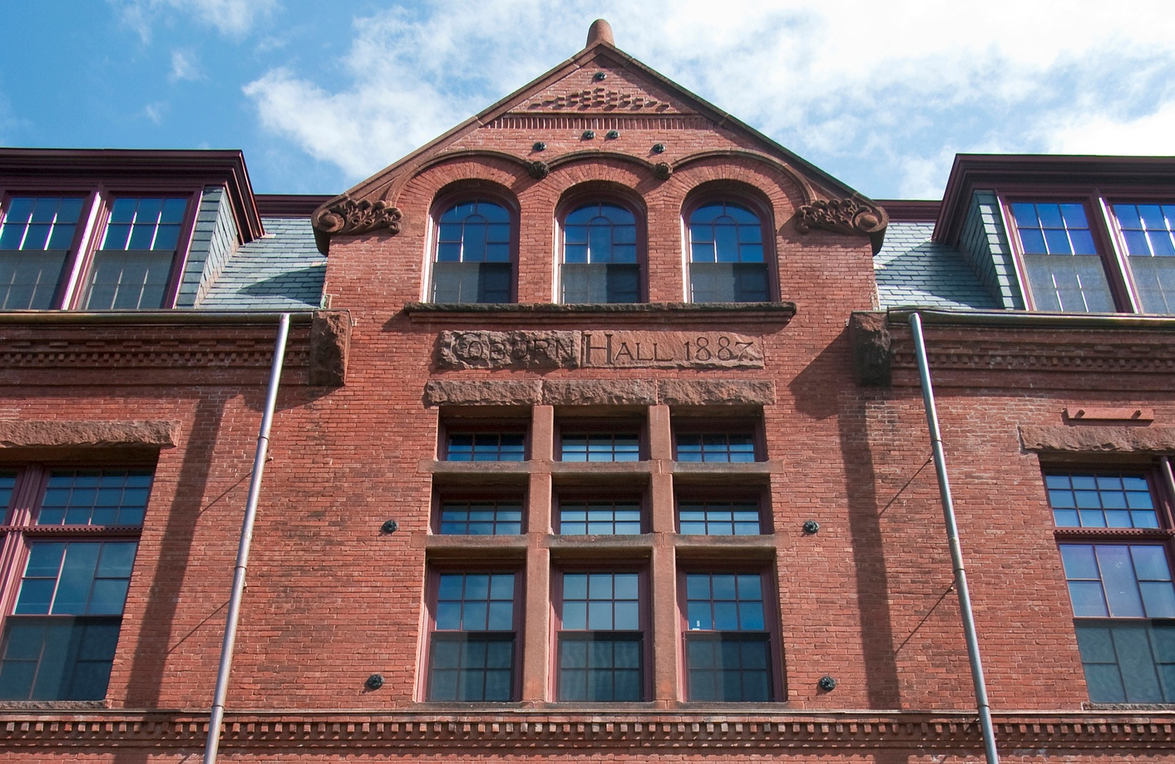
Maine Codes & Preservation

Slide 2
Copyright 2018
Created and narrated by R. Michael Pullen, A.I.A., LEED, Artifex A.E., Bangor, Maine
For the Historic Preservation Program, City of Portland, Maine
and the Maine Historic Preservation Commission, Augusta, Maine
This publication has been financed in part with Federal funds from the National Park Service, Department of the Interior. However, the contents and opinions do not necessarily reflect the views and policies of the Department of the Interior, nor does the mention of trade names or commercial products constitute endorsement or recommendation by the Department of the Interior. The Maine Historic Preservation Commission receives Federal financial assistance for identification and protection of historic properties. Under Title VI of the Civil Rights Act of 1964 and section 504 of the Rehabilitation Act of 1973, the U.S. Department of the Interior prohibits discrimination on the basis of race, color, national origin, or handicap in its federally assisted program. If you believe you have been discriminated against in any program, activity, or facility as described above, or if you desire further information, please write to:
Office of Equal Opportunity
National Park Service
1849 C Street, N.W.
Washington, D. C. 20240
Maine Codes & Preservation

Slide 3
“ Rehabilitating historic buildings involves compliance with
code and regulatory requirements, including accessibility, building
and life safety, and seismic upgrades.”
Technical Preservation Services, Nat’l. Park Service
Maine Codes & Preservation

Slide 4
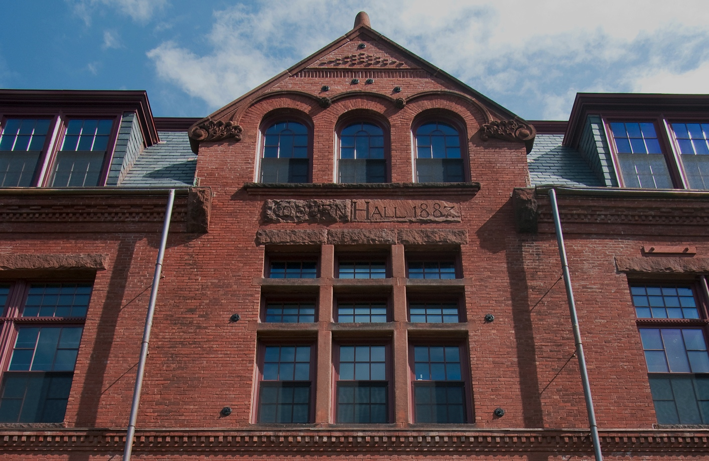
Maine’s Uniform Code (MUBEC)
IEBC 2015 & Preservation
NFPA LSC 101 & Preservation
State & Federal Accessibility Acts
Preservation Challenges & Successes
Maine Codes & Preservation

Slide 5
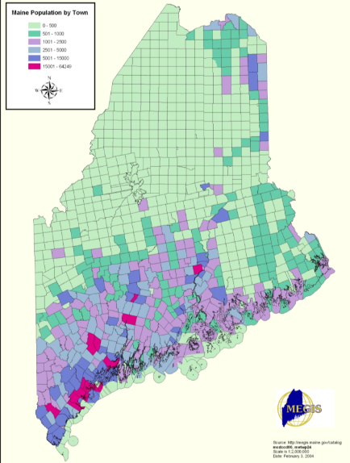
Maine’s Uniform Code
Prior to the 2010 adoption of the MUBEC, a “patchwork quilt” of codes existed, leading to unnecessary confusion, and extra time & costs for permitting.
Existing and historic buildings required a more flexible approach to compliance, than that offered by the IBC.
MUBEC applies to communities >4,000 in population, and others that choose to adopt either MUBEC, MUBC, or MUEC.
“There is a need to make historic preservation a policy priority by way of model codes, to facilitate adaptive reuse and alternate compliance methods for historic buildings”.
Maine Codes & Preservation

Slide 6
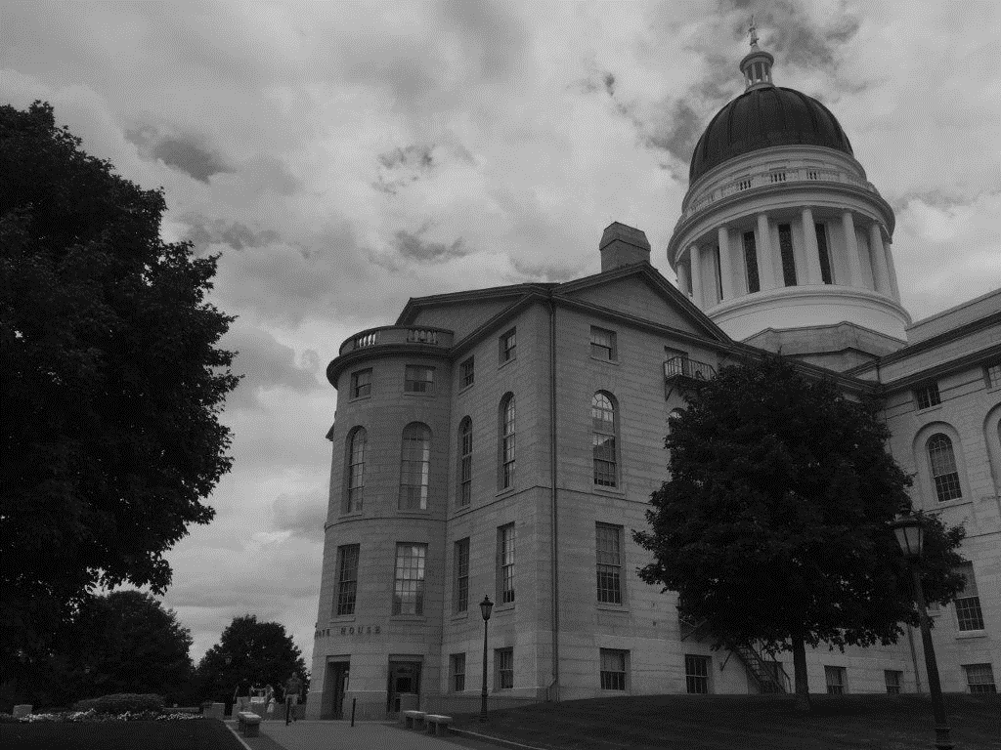
features of the mubec
Current Codes & Standards:
International Building Code (IBC) 2015
International Residential Code (IRC) 2015
International Existing Building Code (IEBC) 2015
International Energy Conservation Code (IECC) 2009
ASHRAE Standards; 62.1-2007, 62.2-2007 and 90.1-2007
Maine Model Radon Standard ASTM 1465-06
Maine Codes & Preservation

Slide 7
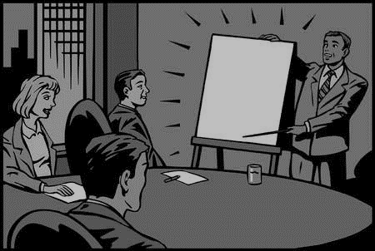
features of the mubec
MUBEC Board Duties/ Composition:
Adopt, amend & maintain the MUBEC
Resolve conflicts between ICC & NFPA Codes
Board members represent Code Officials, Architects, Builders, Energy & Structural professionals
Historic Preservation interests are represented on the Board
Maine Codes & Preservation

Slide 8
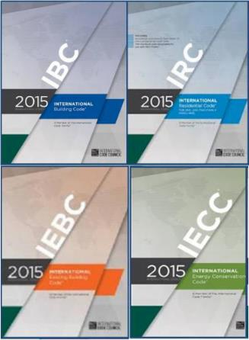
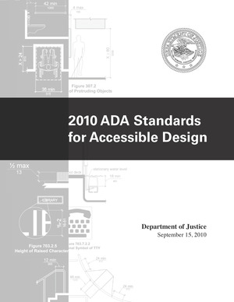
Provisions for historic buildings
IEBC International Existing Building Code
IECC International Energy Conservation Code
NFPA LSC 101(Fire Code)
Americans with Disabilities Act (ADA)
Maine Codes & Preservation

Slide 9
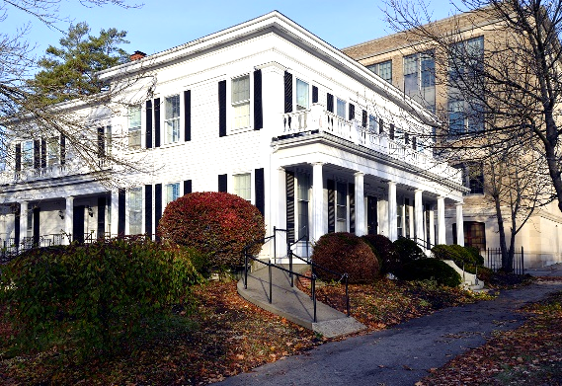
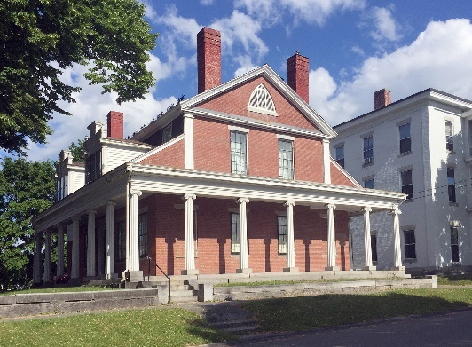
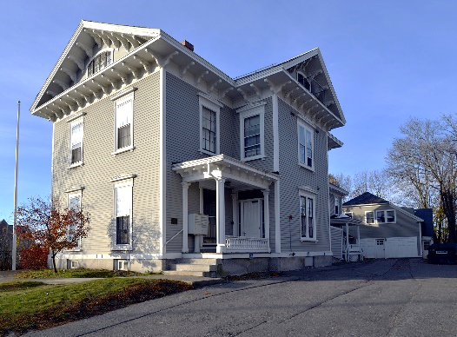
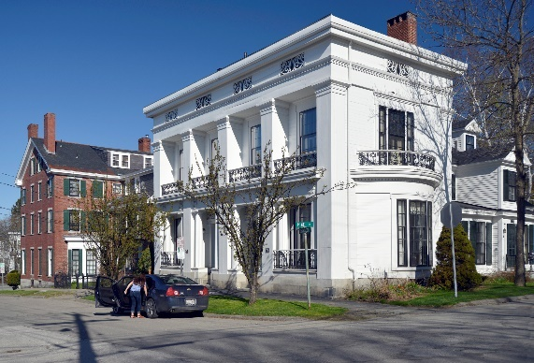
historic building defined
Listed or preliminarily determined to be eligible for listing in the National Register of Historic Places;
Determined by the Secretary of the US Dept. of the Interior to contribute to the historical significance of a registered historic district or a district preliminarily determined to qualify as a historic district;
Designated as historic under a state or local historic preservation program that is approved by the Dept. of the Interior.
Maine Codes & Preservation

Slide 10
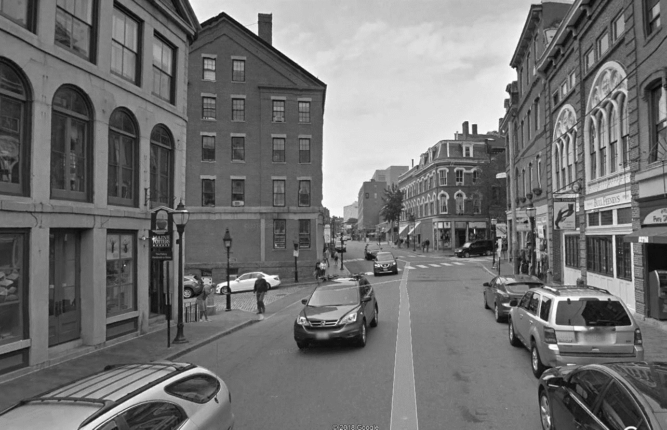
Provisions for historic buildings
IEBC International Existing Building Code
Maine Codes & Preservation

Slide 11
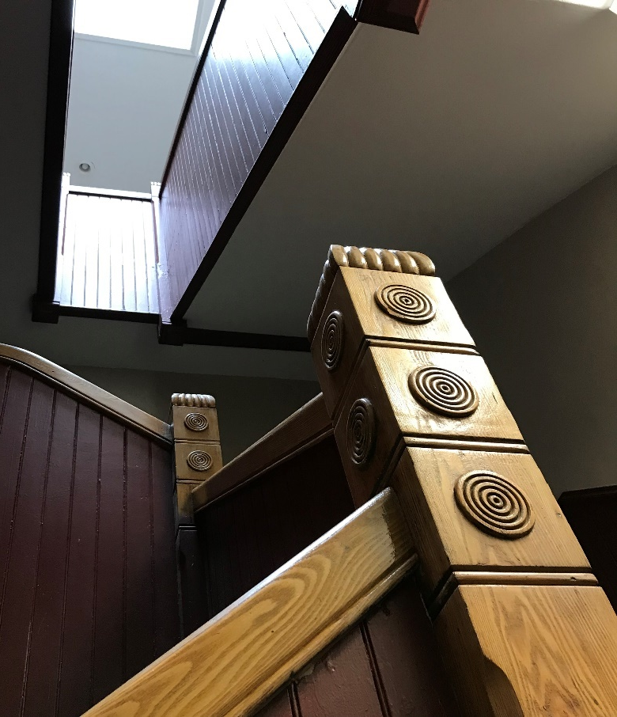
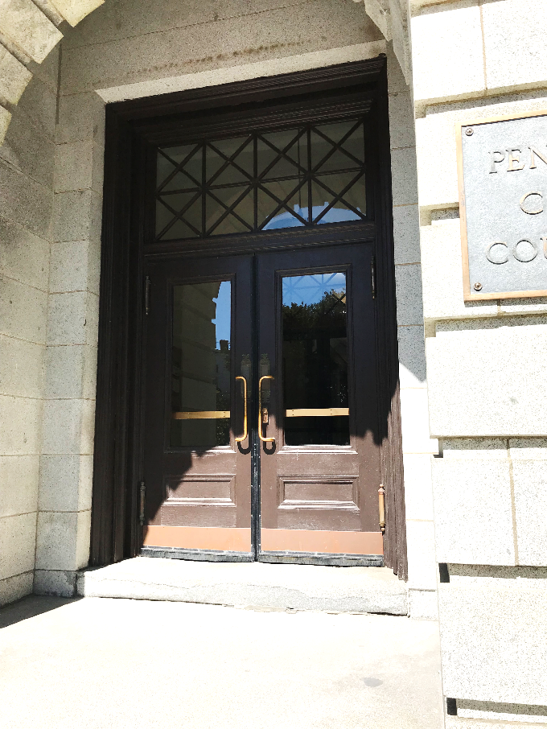
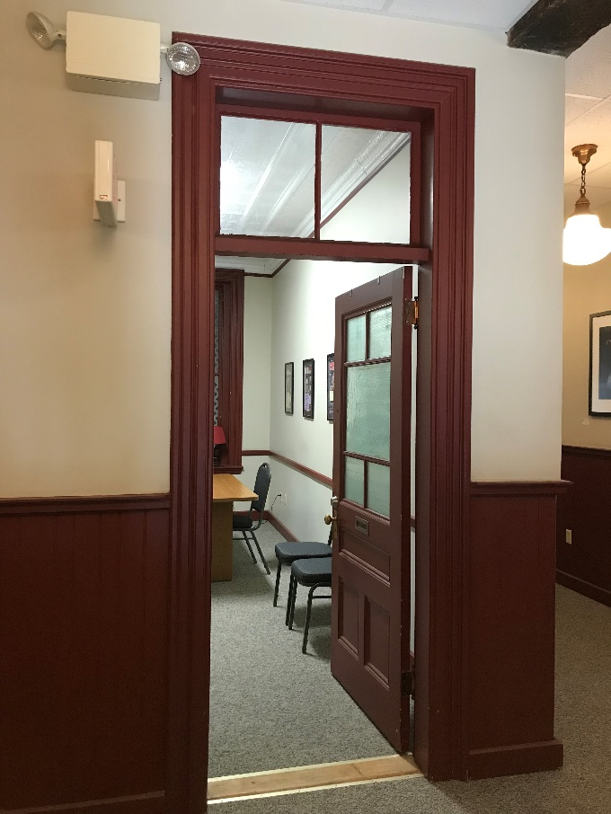
Provisions for historic buildings
IEBC International Existing Building Code
Maine Codes & Preservation

Slide 12
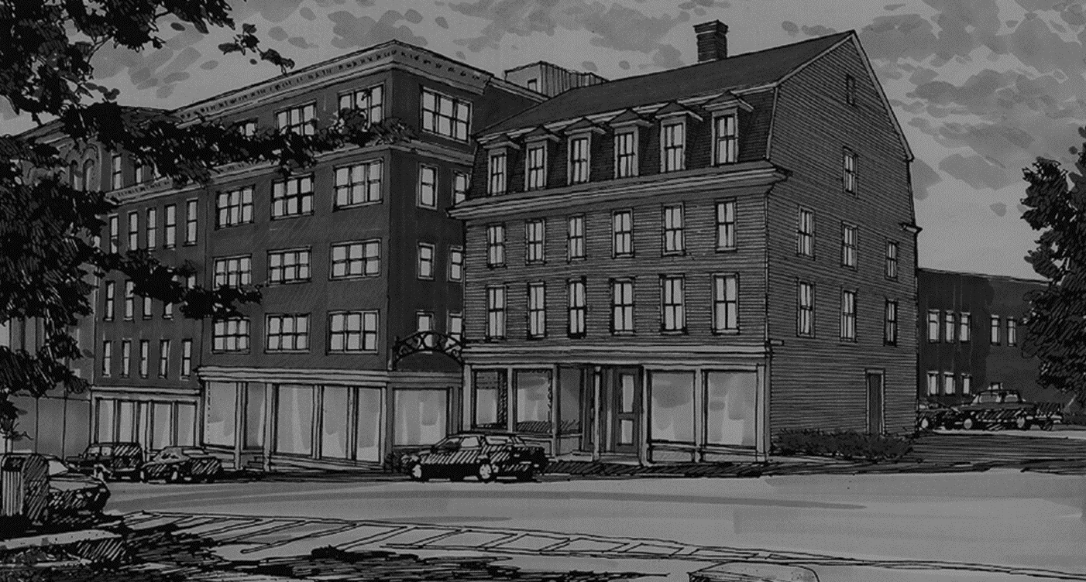
International existing building code (iebc)
Compliance Options
Prescriptive Method
Work Area Method
Performance Method
Maine Codes & Preservation

Slide 13
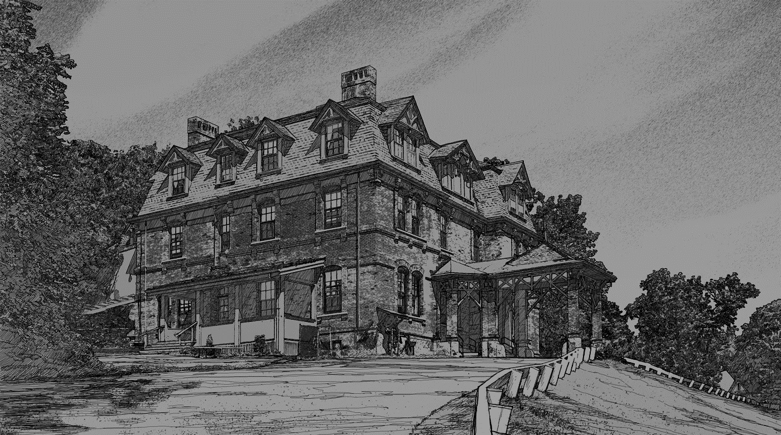
International existing building code (iebc)
Levels of Alteration
Maintenance & Repairs
Alterations
Changes of Occupancy & Use
Additions, New Work
Maine Codes & Preservation

Slide 14
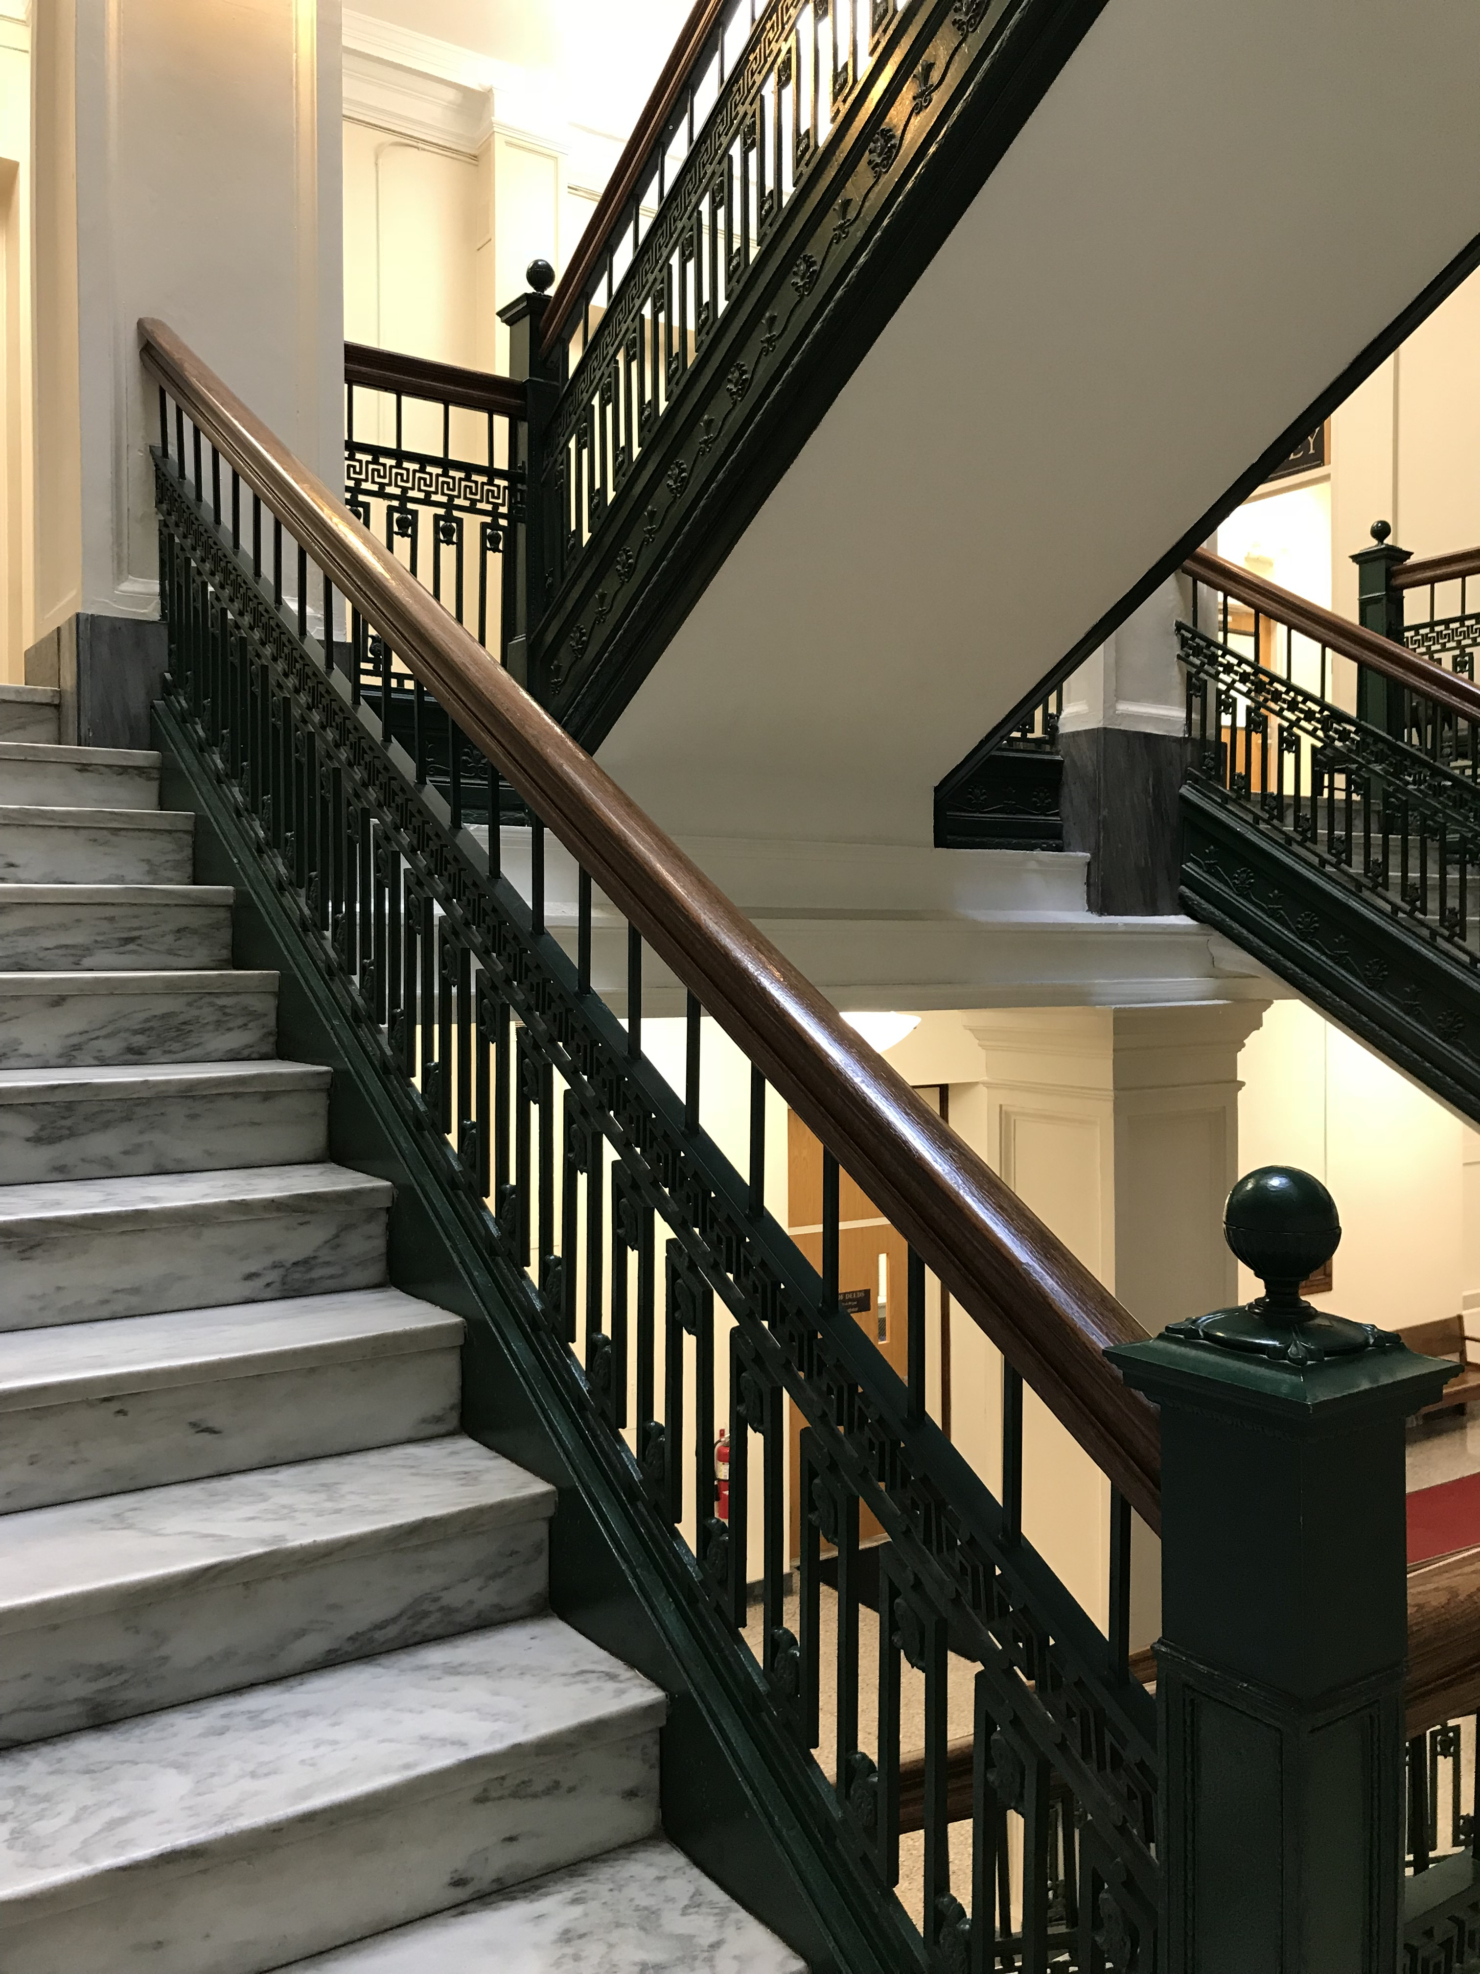
International existing building code (iebc)
Historic Building Evaluations
Compliant Safety Features
Defining Code Deficiencies
Providing Equivalent Levels of Safety
Maine Codes & Preservation

Slide 15
Provisions for historic buildings
NFPA Life Safety Code 101
Section 43.10 Historic Buildings
Evaluation on Historic Building required
Replacement of missing features permitted
Allowances for MOE, Door Swings, Transoms,
Stairway Enclosures and Rated Assemblies
Maine Codes & Preservation

Slide 16
Role of maine’s hp commissions
Protect local Historic Resources.
Provide Reviews for COA.
Act as Liaisons for HP to Govt. and the Public.
Maine Codes & Preservation

Slide 17
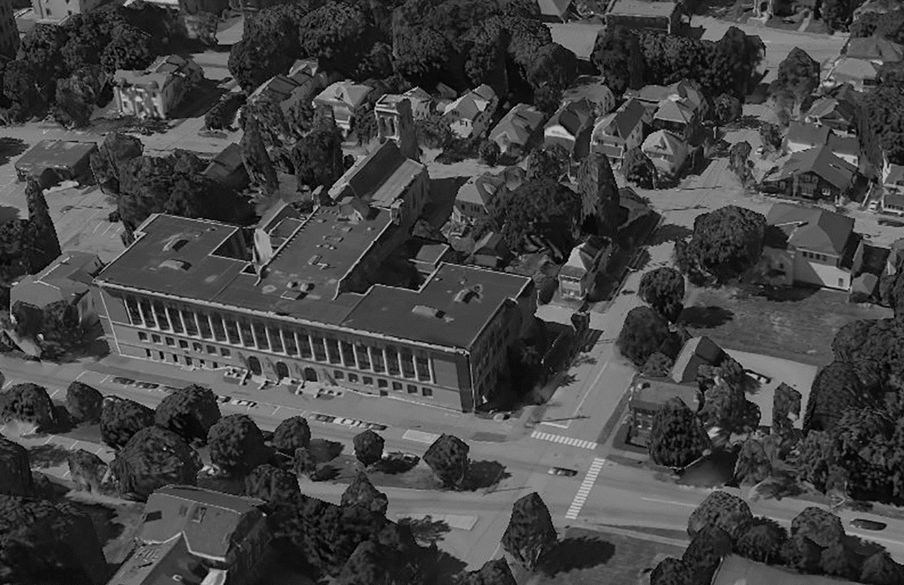
Key hp Ordinance terms
Minor Revisions
Maintenance
Character-Defining Features
Maine Codes & Preservation

Slide 18
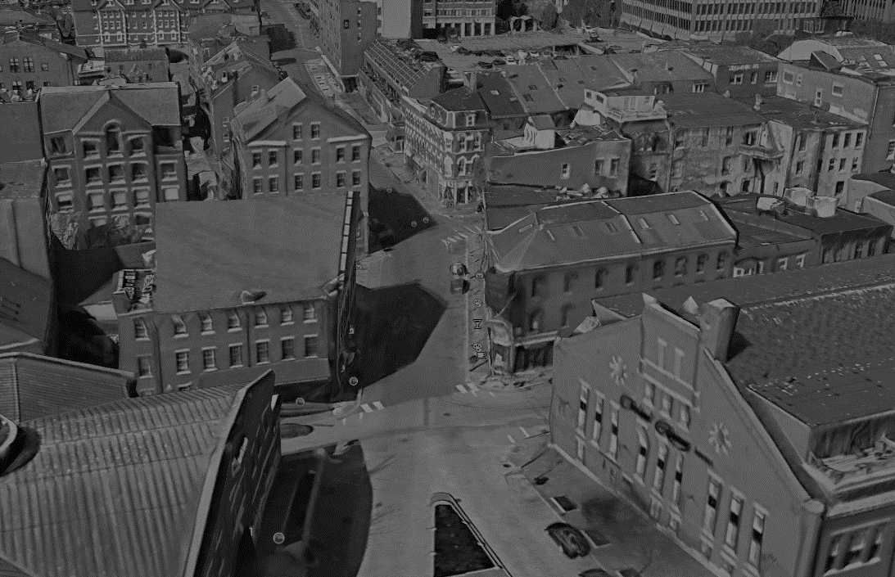
Preservation challenges
Changes in Occupancy & Use
Character-Defining Features
Accessibility
Means of Egress
Energy Upgrades
Rooftop Structures
7. Character-Defining Features
8. Maintenance
Maine Codes & Preservation

Slide 19
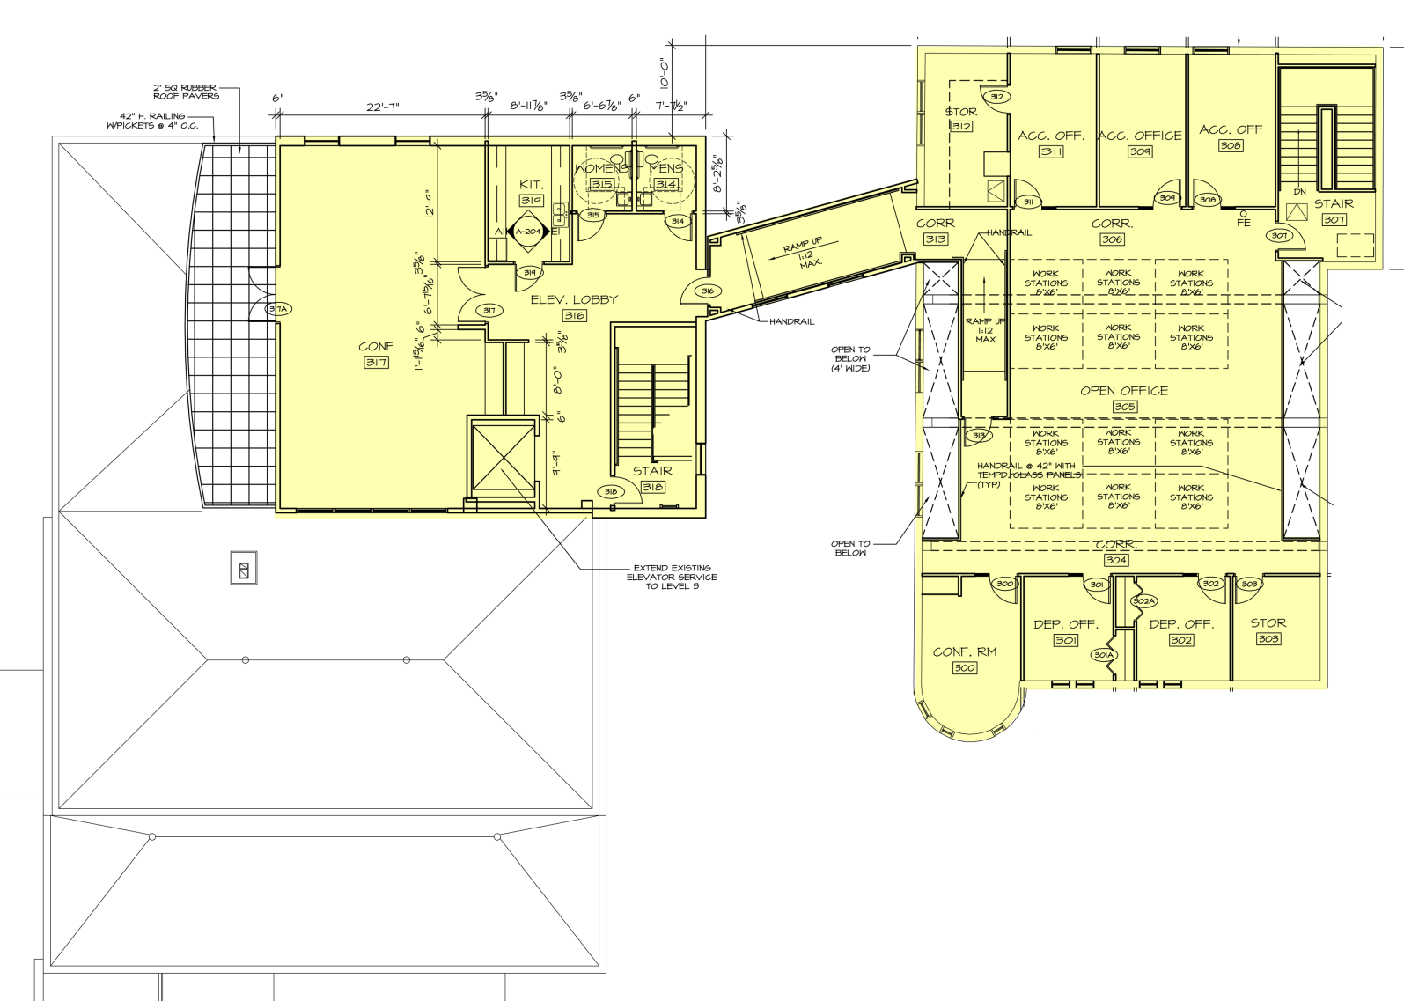
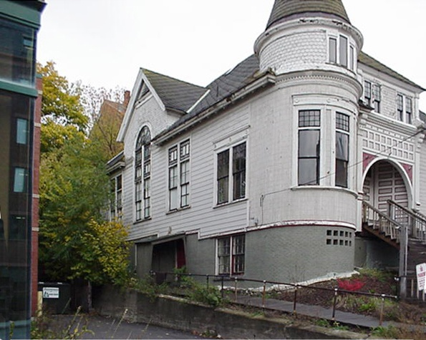
Preservation challenges
Changes in Occupancy & Use
Merrill Bank acquires theatre building and expands into the 1888 Vestry.
Assembly to Business Occupancy
Maine Codes & Preservation

Slide 20
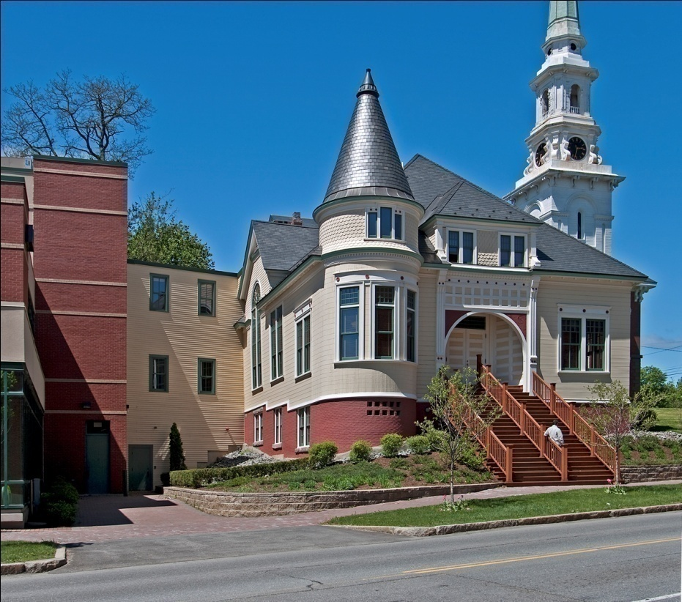
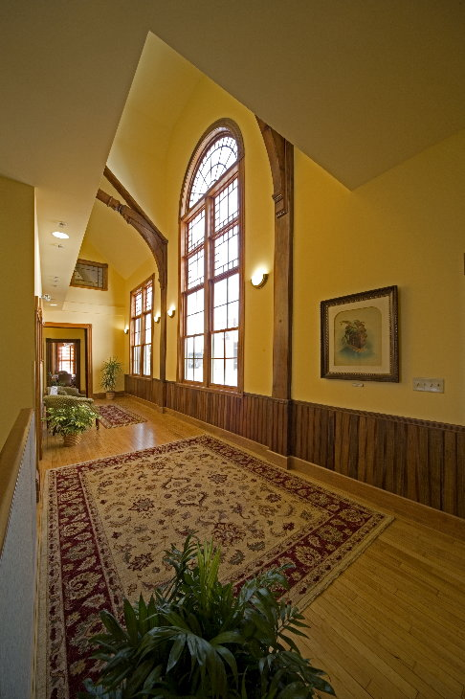
Preservation challenges
Changes in Occupancy & Use
Maine Codes & Preservation

Slide 21
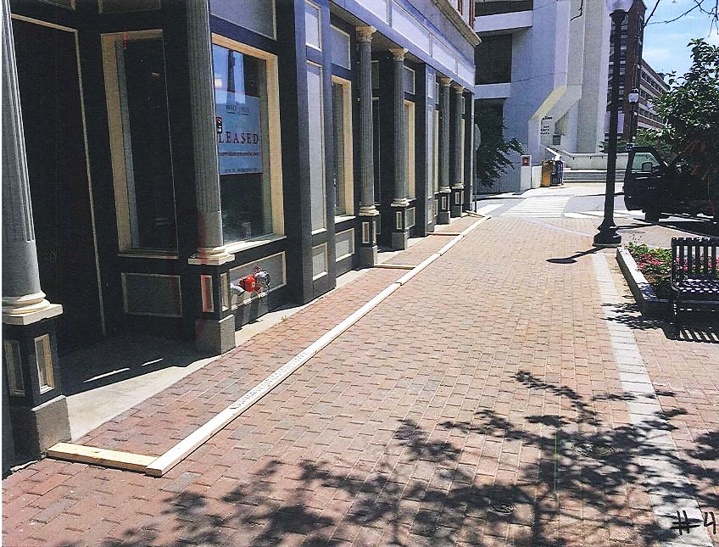
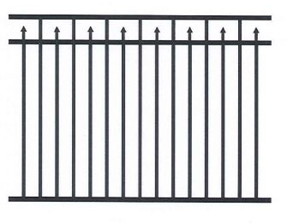
Preservation challenges
Changes in Occupancy & Use
Maine Codes & Preservation

Slide 22
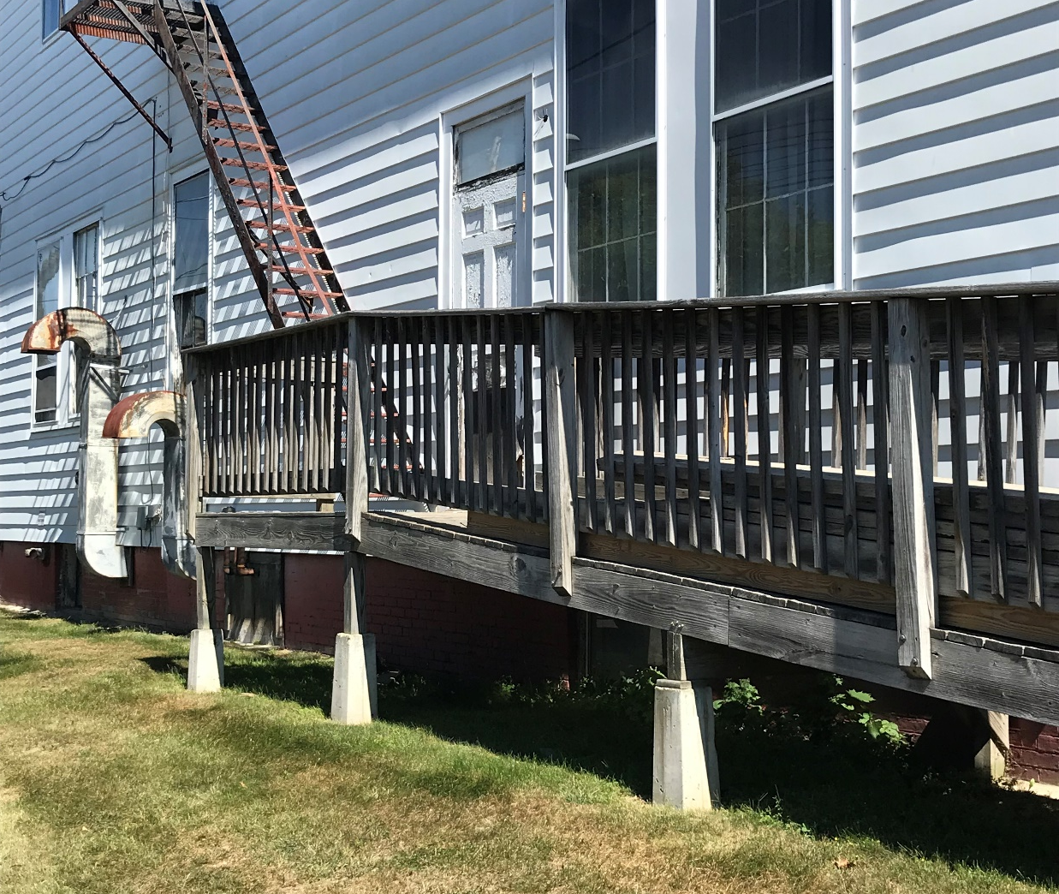
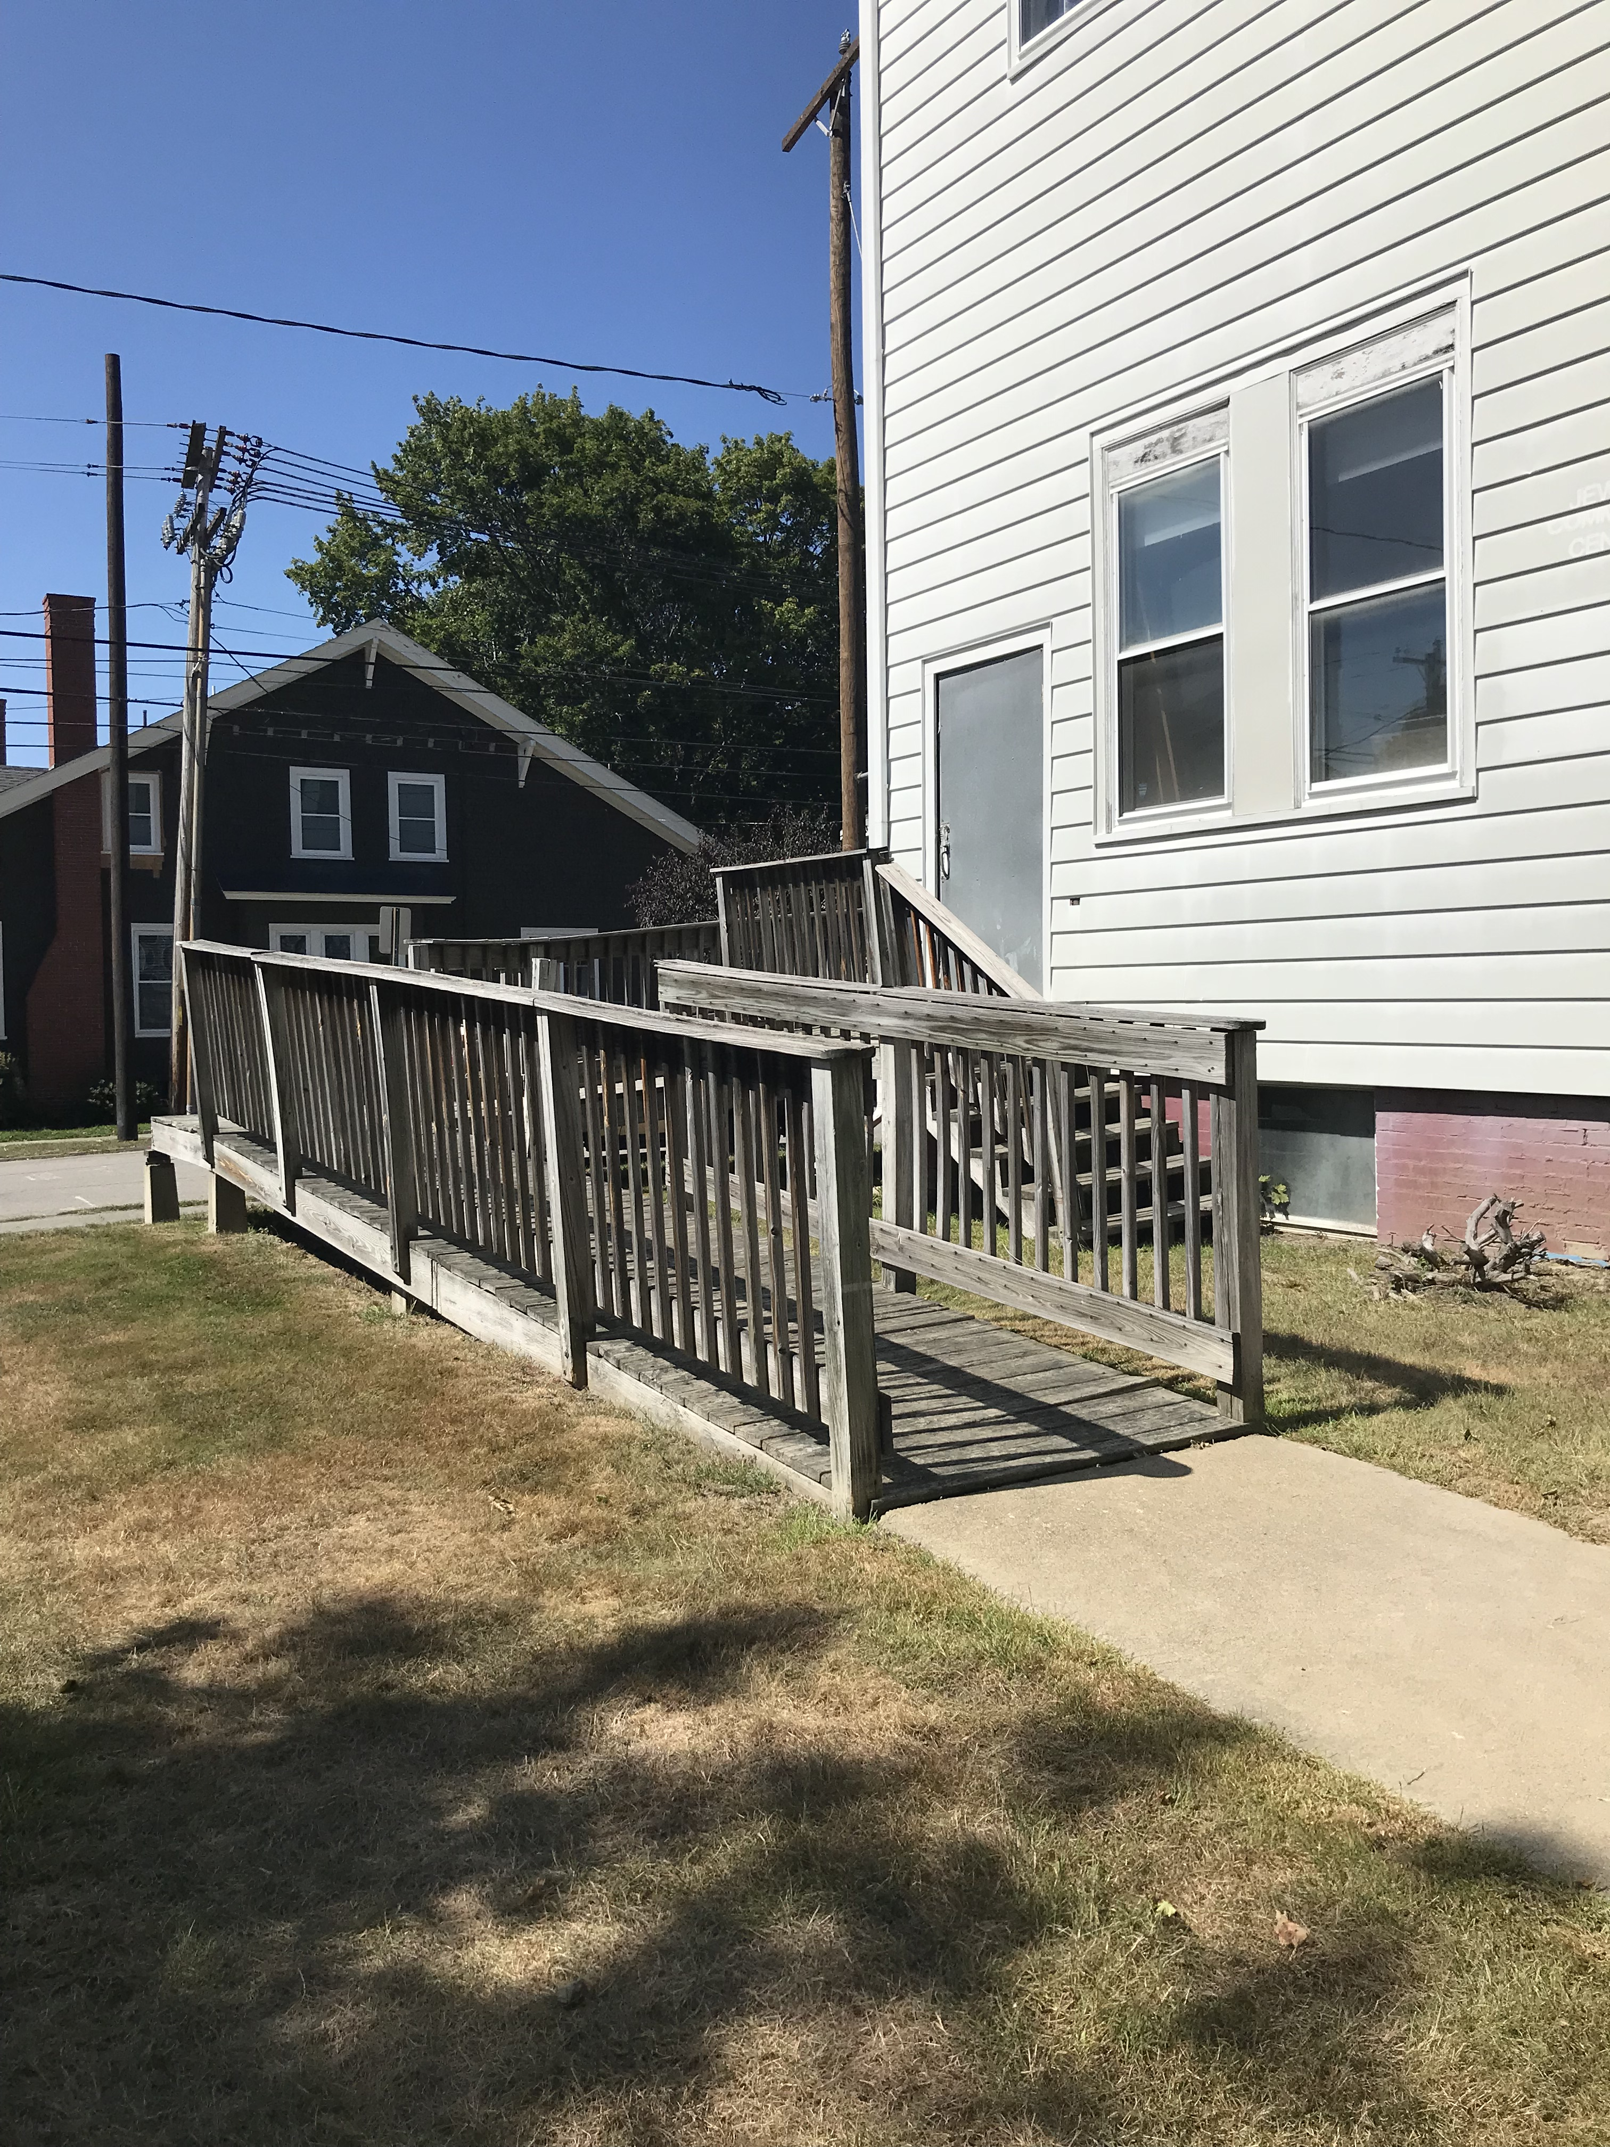
Preservation challenges
Accessibility
Maine Codes & Preservation

Slide 23
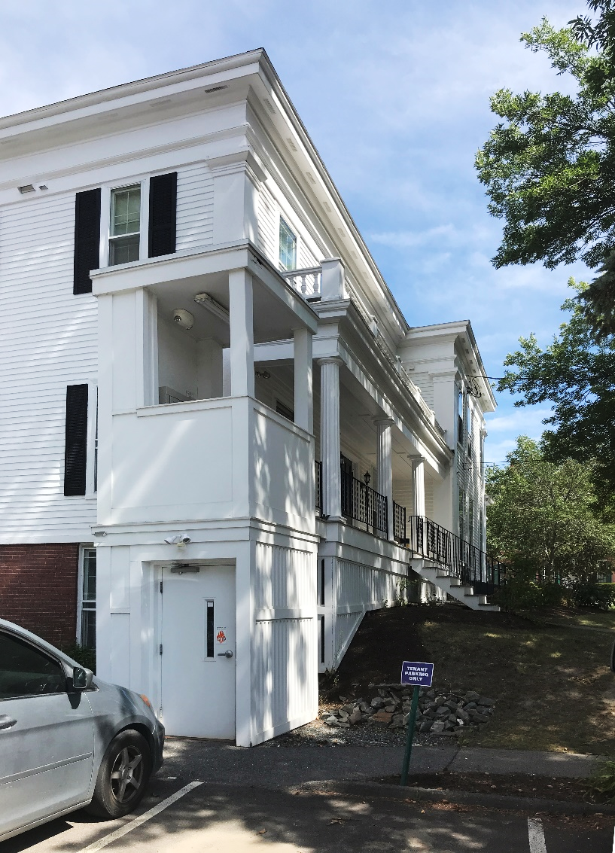
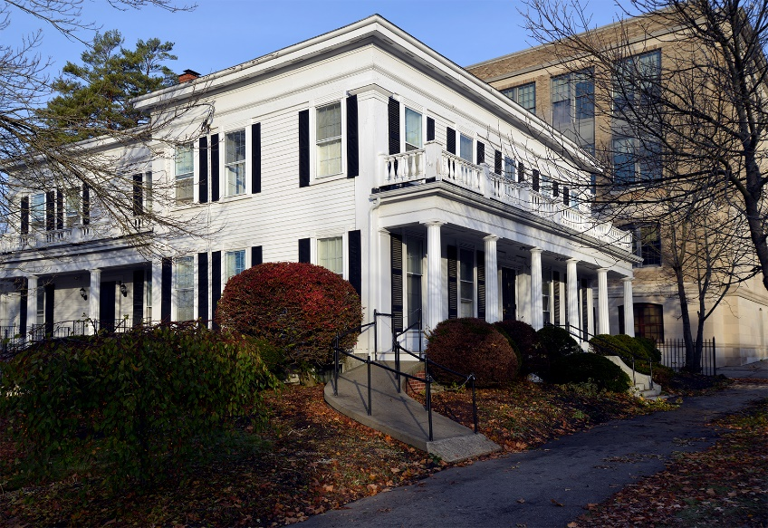
Preservation challenges
Accessibility
Maine Codes & Preservation

Slide 24
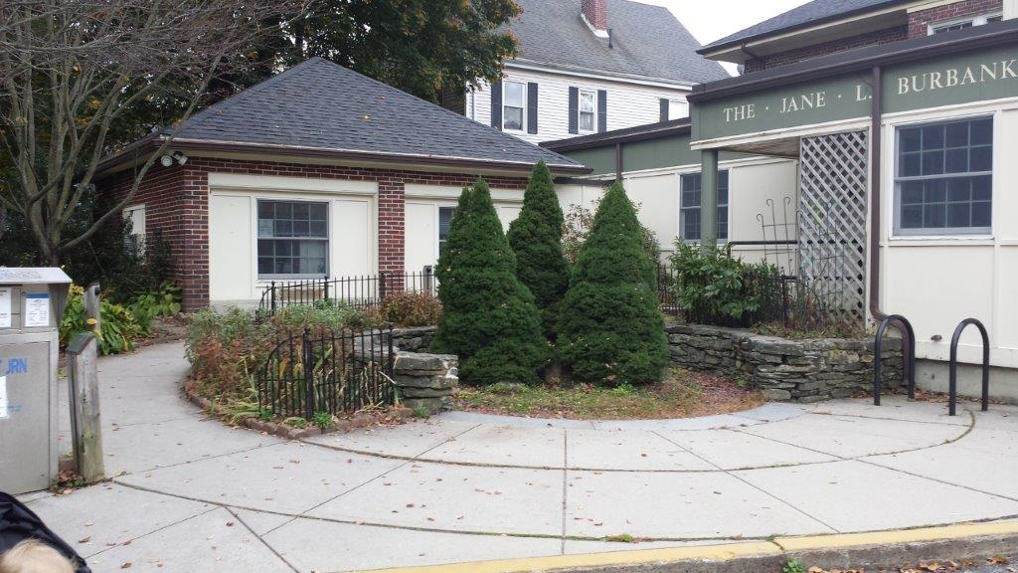
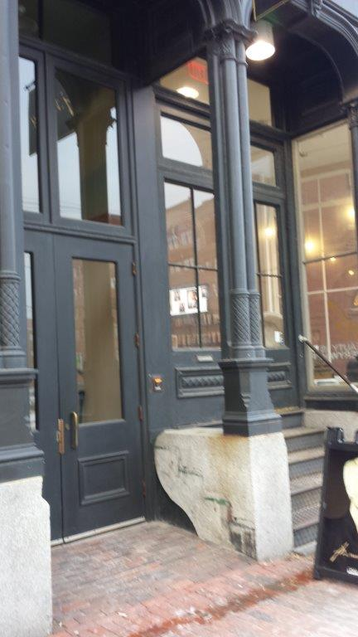
Preservation challenges
Accessibility
Maine Codes & Preservation

Slide 25
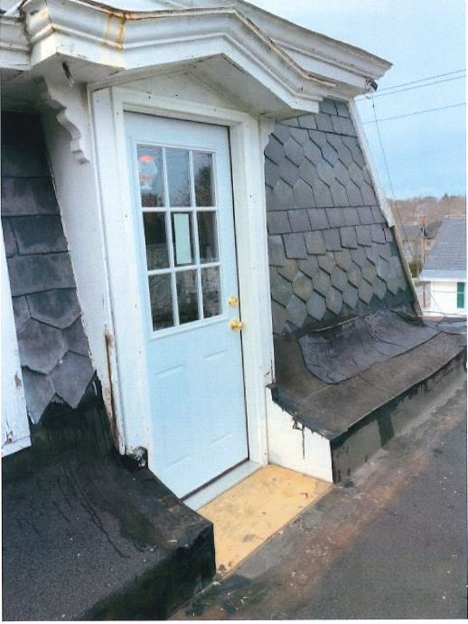
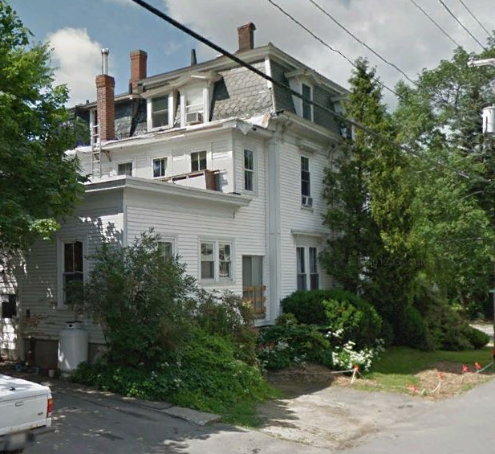
Preservation challenges
Means of Egress
Maine Codes & Preservation

Slide 26
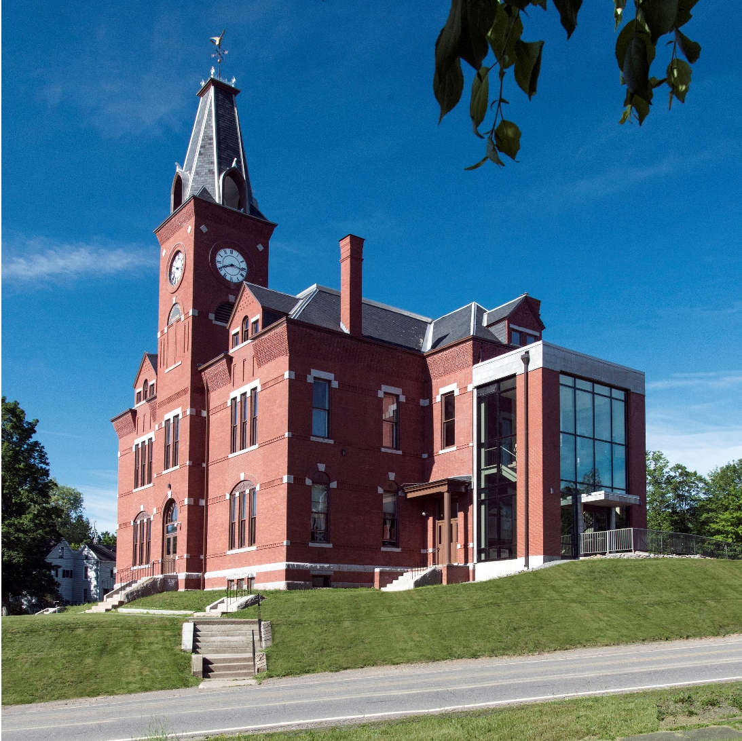
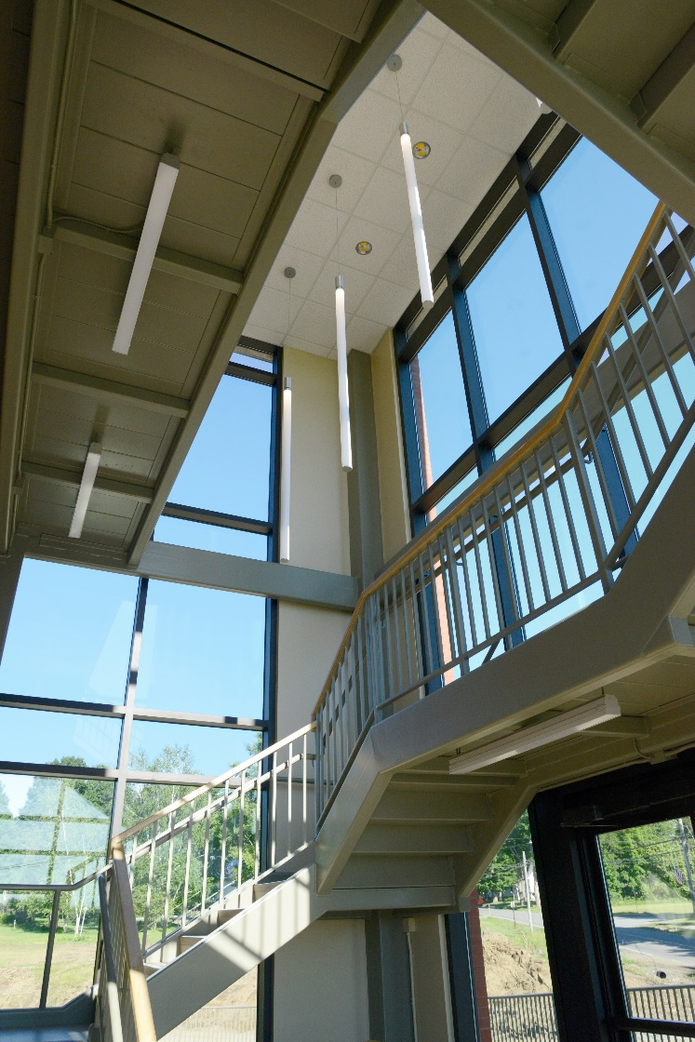
Preservation challenges
Means of Egress
Maine Codes & Preservation

Slide 27
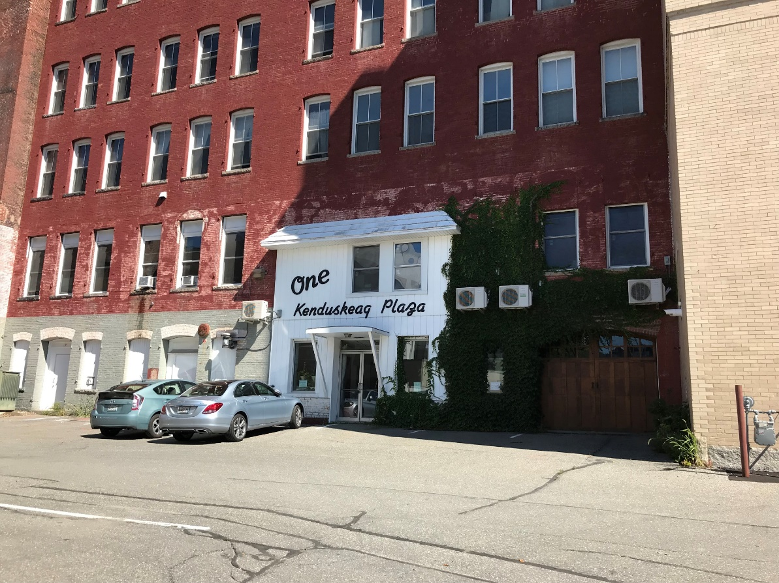
Preservation challenges
Energy Upgrades
Maine Codes & Preservation

Slide 28
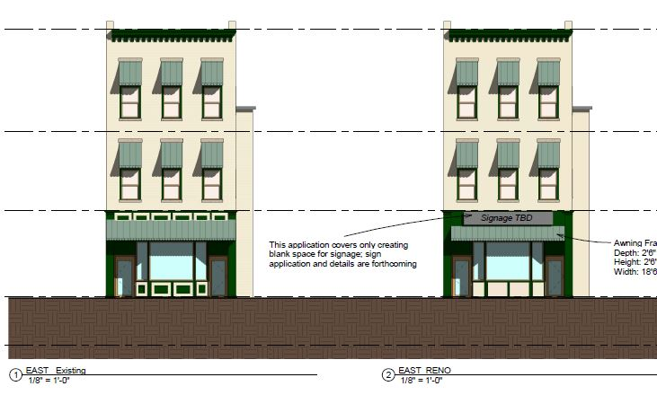
Preservation challenges
Energy Upgrades
Maine Codes & Preservation

Slide 29
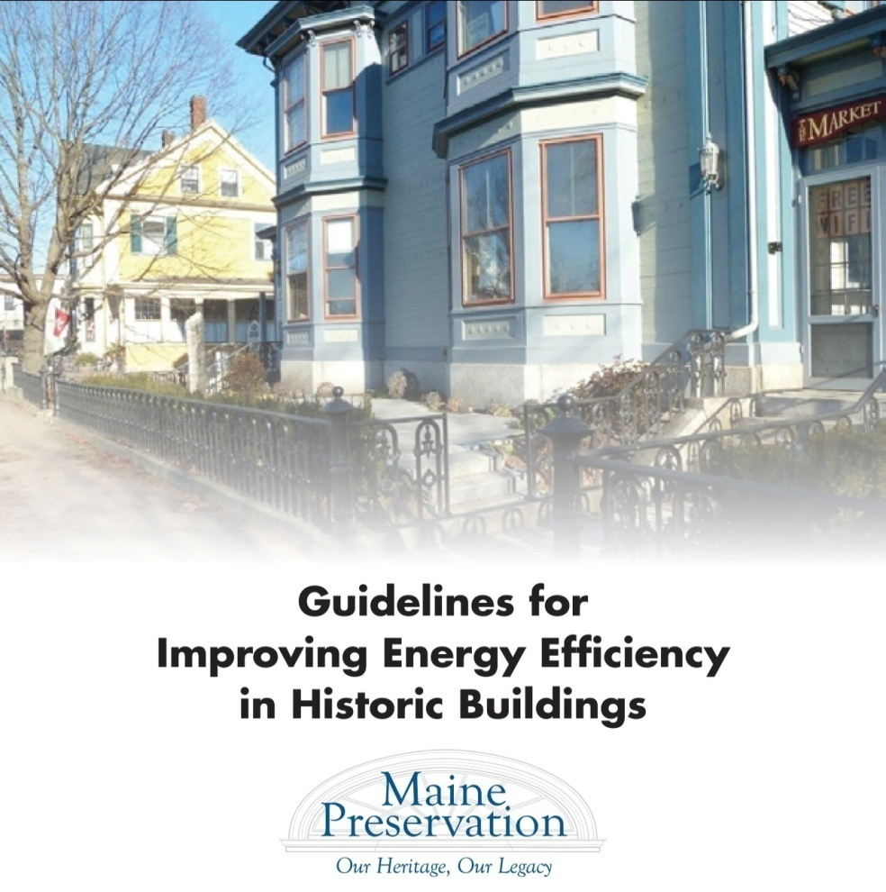
Strategies for rehabilitation
Improving Energy Efficiencies
in Historic Buildings
Identify & evaluate the historic features of
the building.
Conduct a building performance evaluation.
Retain or restore historic features designed
to save energy & increase comfort.
Determine the most cost effective energy-
saving strategies.
Develop a long-term energy efficiency plan.
Employ durable and repairable materials.
Make changes that are reversible and can
be monitored.
Control moisture, particularly in walls and
basements, and for unhealthy air quality.
Maine Codes & Preservation

Slide 30
Preservation challenges
Rooftop Structures
Maine Codes & Preservation

Slide 31
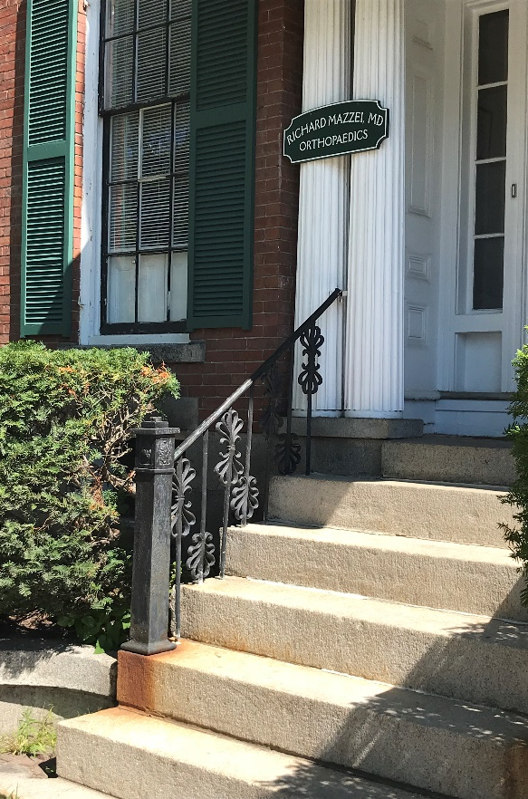
Preservation challenges
Character-Defining Features
“The removal of historic materials or alterations of features and spaces
that characterize a property shall be avoided.”
Maine Codes & Preservation

Slide 32
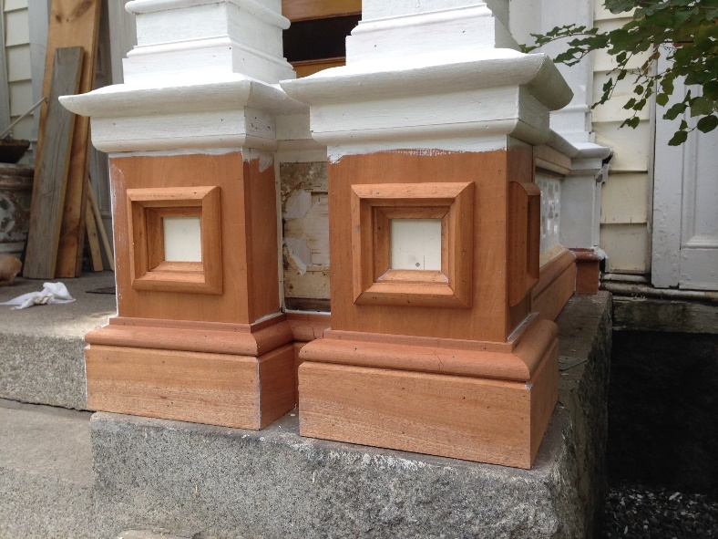
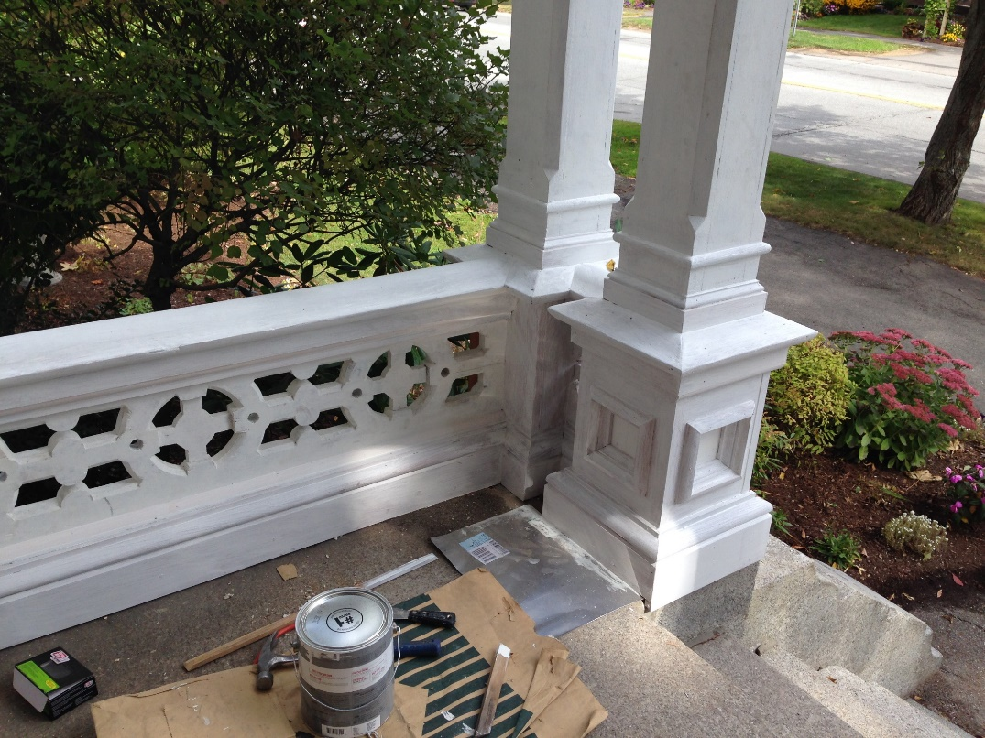
Preservation challenges
Character-Defining Features
“The removal of historic materials or alterations of features and spaces
that characterize a property shall be avoided.”
Maine Codes & Preservation

Slide 33
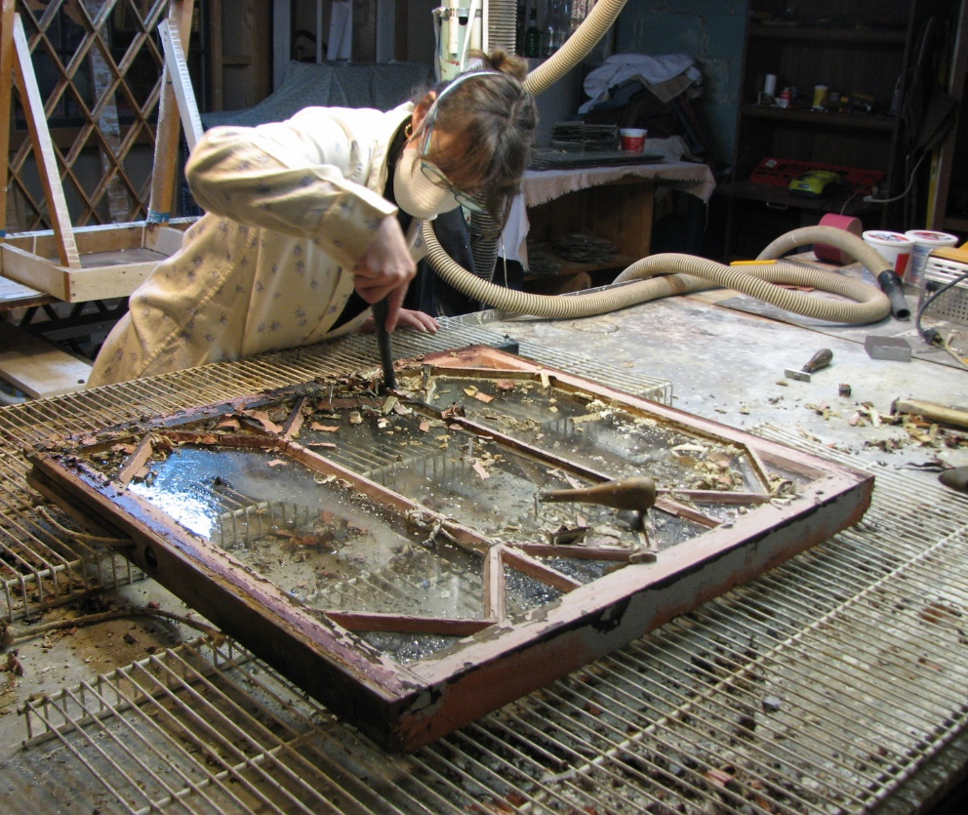
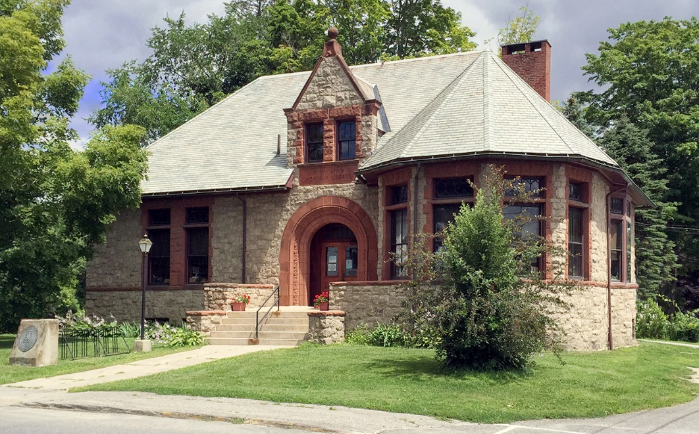
Preservation challenges
Character-Defining Features
“The removal of historic materials or alterations of features and spaces
that characterize a property shall be avoided.”
Maine Codes & Preservation

Slide 34
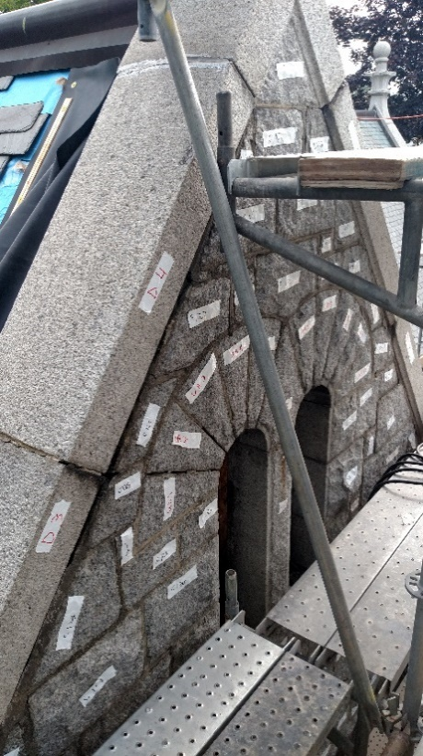
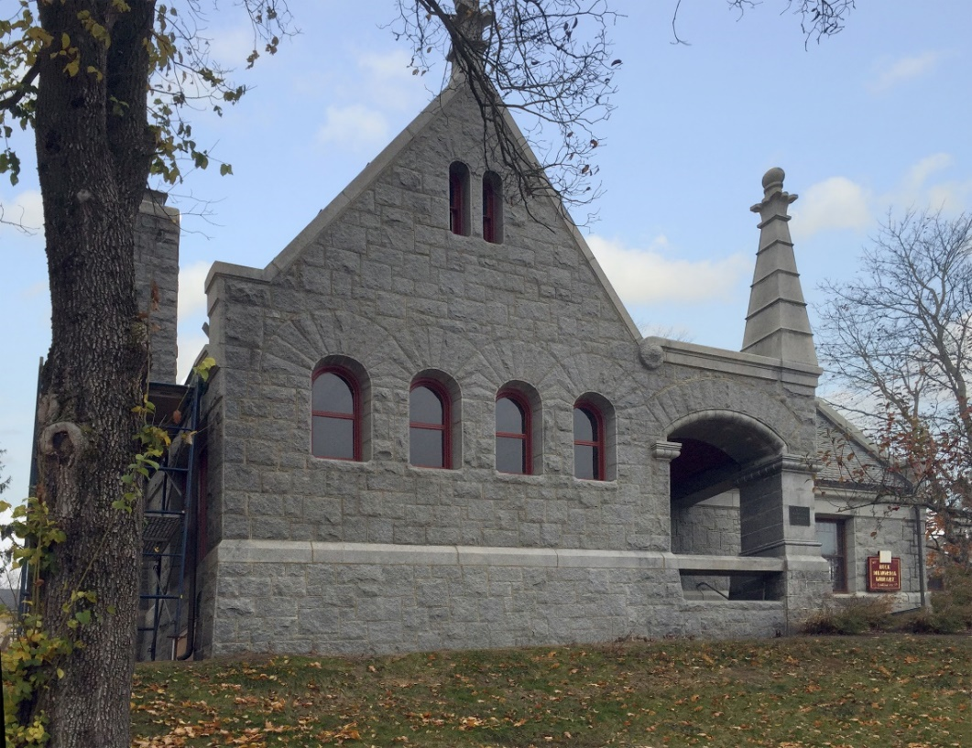
Preservation challenges
Character-Defining Features
“The removal of historic materials or alterations of features and spaces
that characterize a property shall be avoided.”
Maine Codes & Preservation

Slide 35
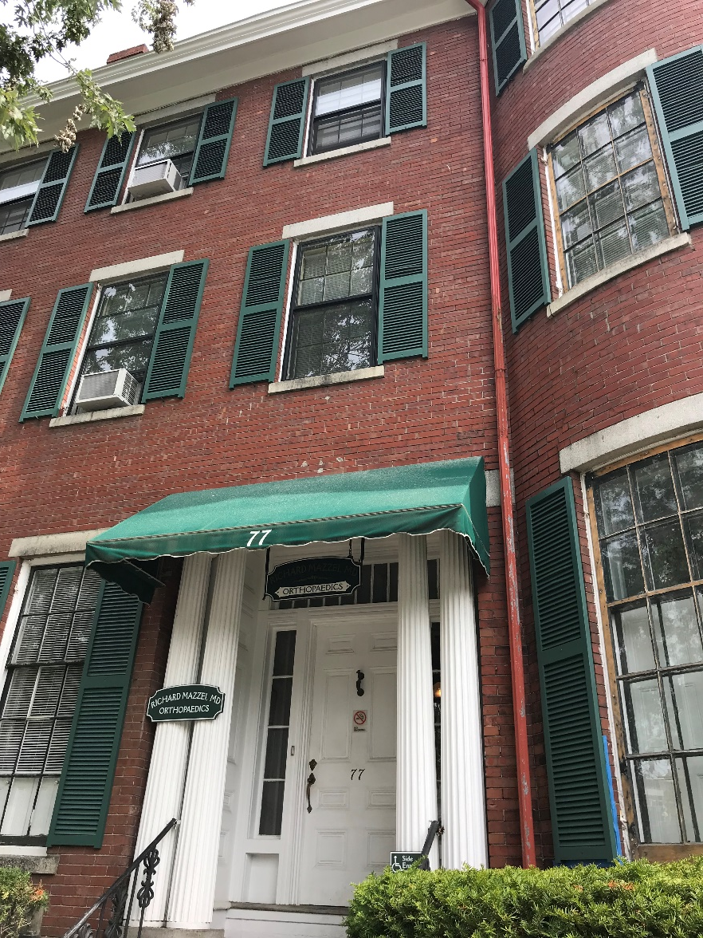
Preservation challenges
Windows
Maine Codes & Preservation

Slide 36
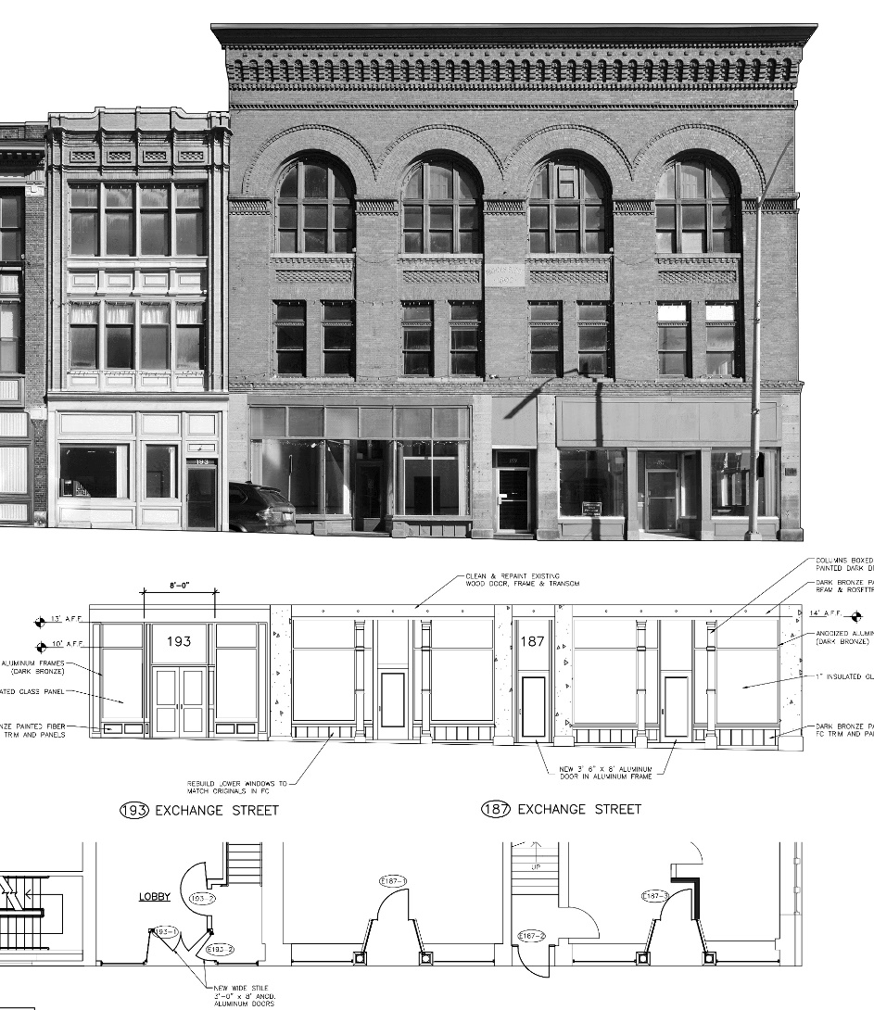
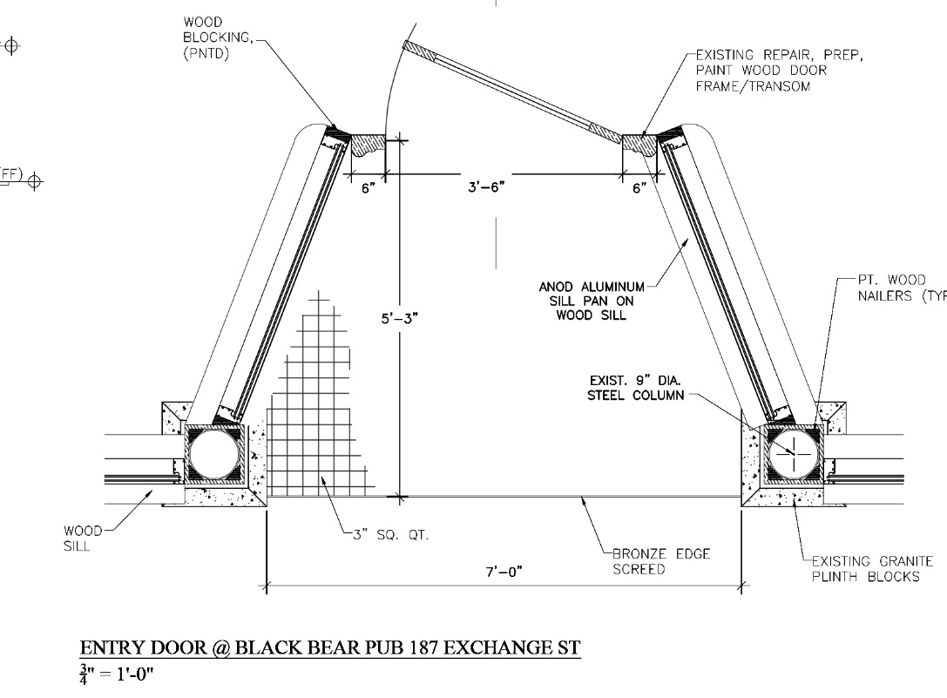
Preservation challenges
Storefront Windows
Maine Codes & Preservation

Slide 37
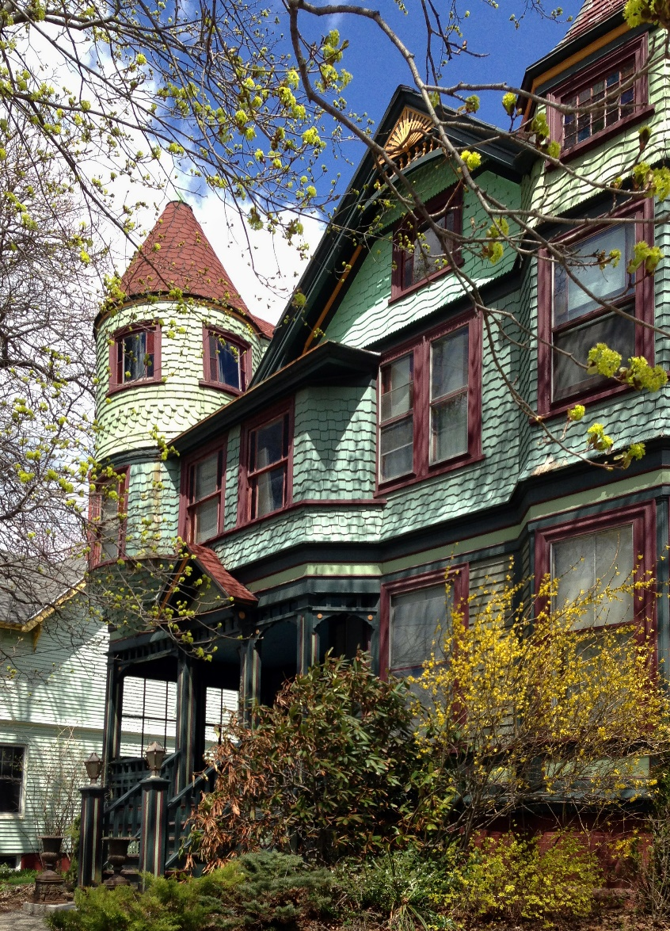
Preservation challenges
Cladding Materials
Maine Codes & Preservation

Slide 38
Preservation challenges
Deferred Maintenance
“Maintenance and repair required….
…shall not permit such historic structure to fall into a state of disrepair….”
Maine Codes & Preservation

Slide 39
Preservation successes
Maine tax credit rehabilitation projects have delivered $856M in Maine since 2008, requiring specialized trades.
Because of the durability of these historic buildings, they are outlasting their more contemporary counterparts.
Maine Codes & Preservation

Slide 40
Sustainable Rehabilitation
Maine Codes & Preservation

Slide 41
Sustainable Rehabilitation
Maine Codes & Preservation

Slide 42
Maine Historic Preservation Commission : www.maine.gov/mhpc/
Maine Downtown Center : www.mdf.org
Maine Preservation : www.mainepreservation.org
National Trust for Historic Preservation : www.preservationnation.org
ME Bur. Of Codes & Standards : www.maine.gov/dps/bbcs
Maine Codes & Preservation

